Slide 1
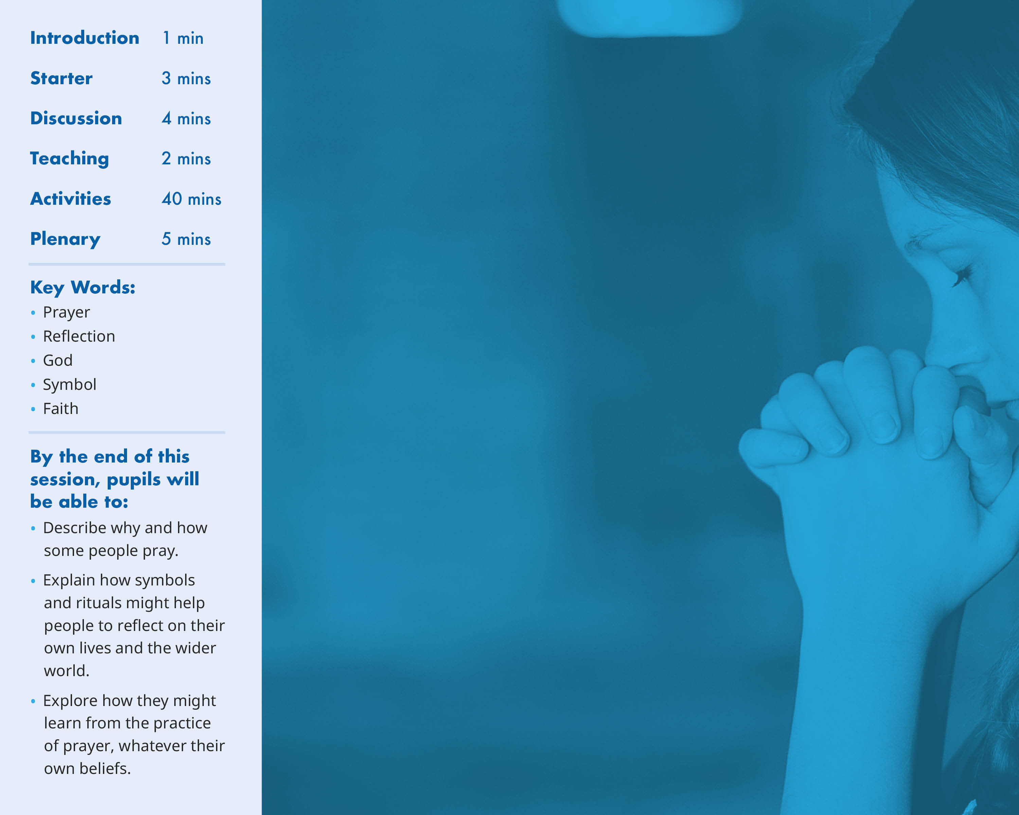
I am…
I am here from…
The reason I am here is…

Slide 2
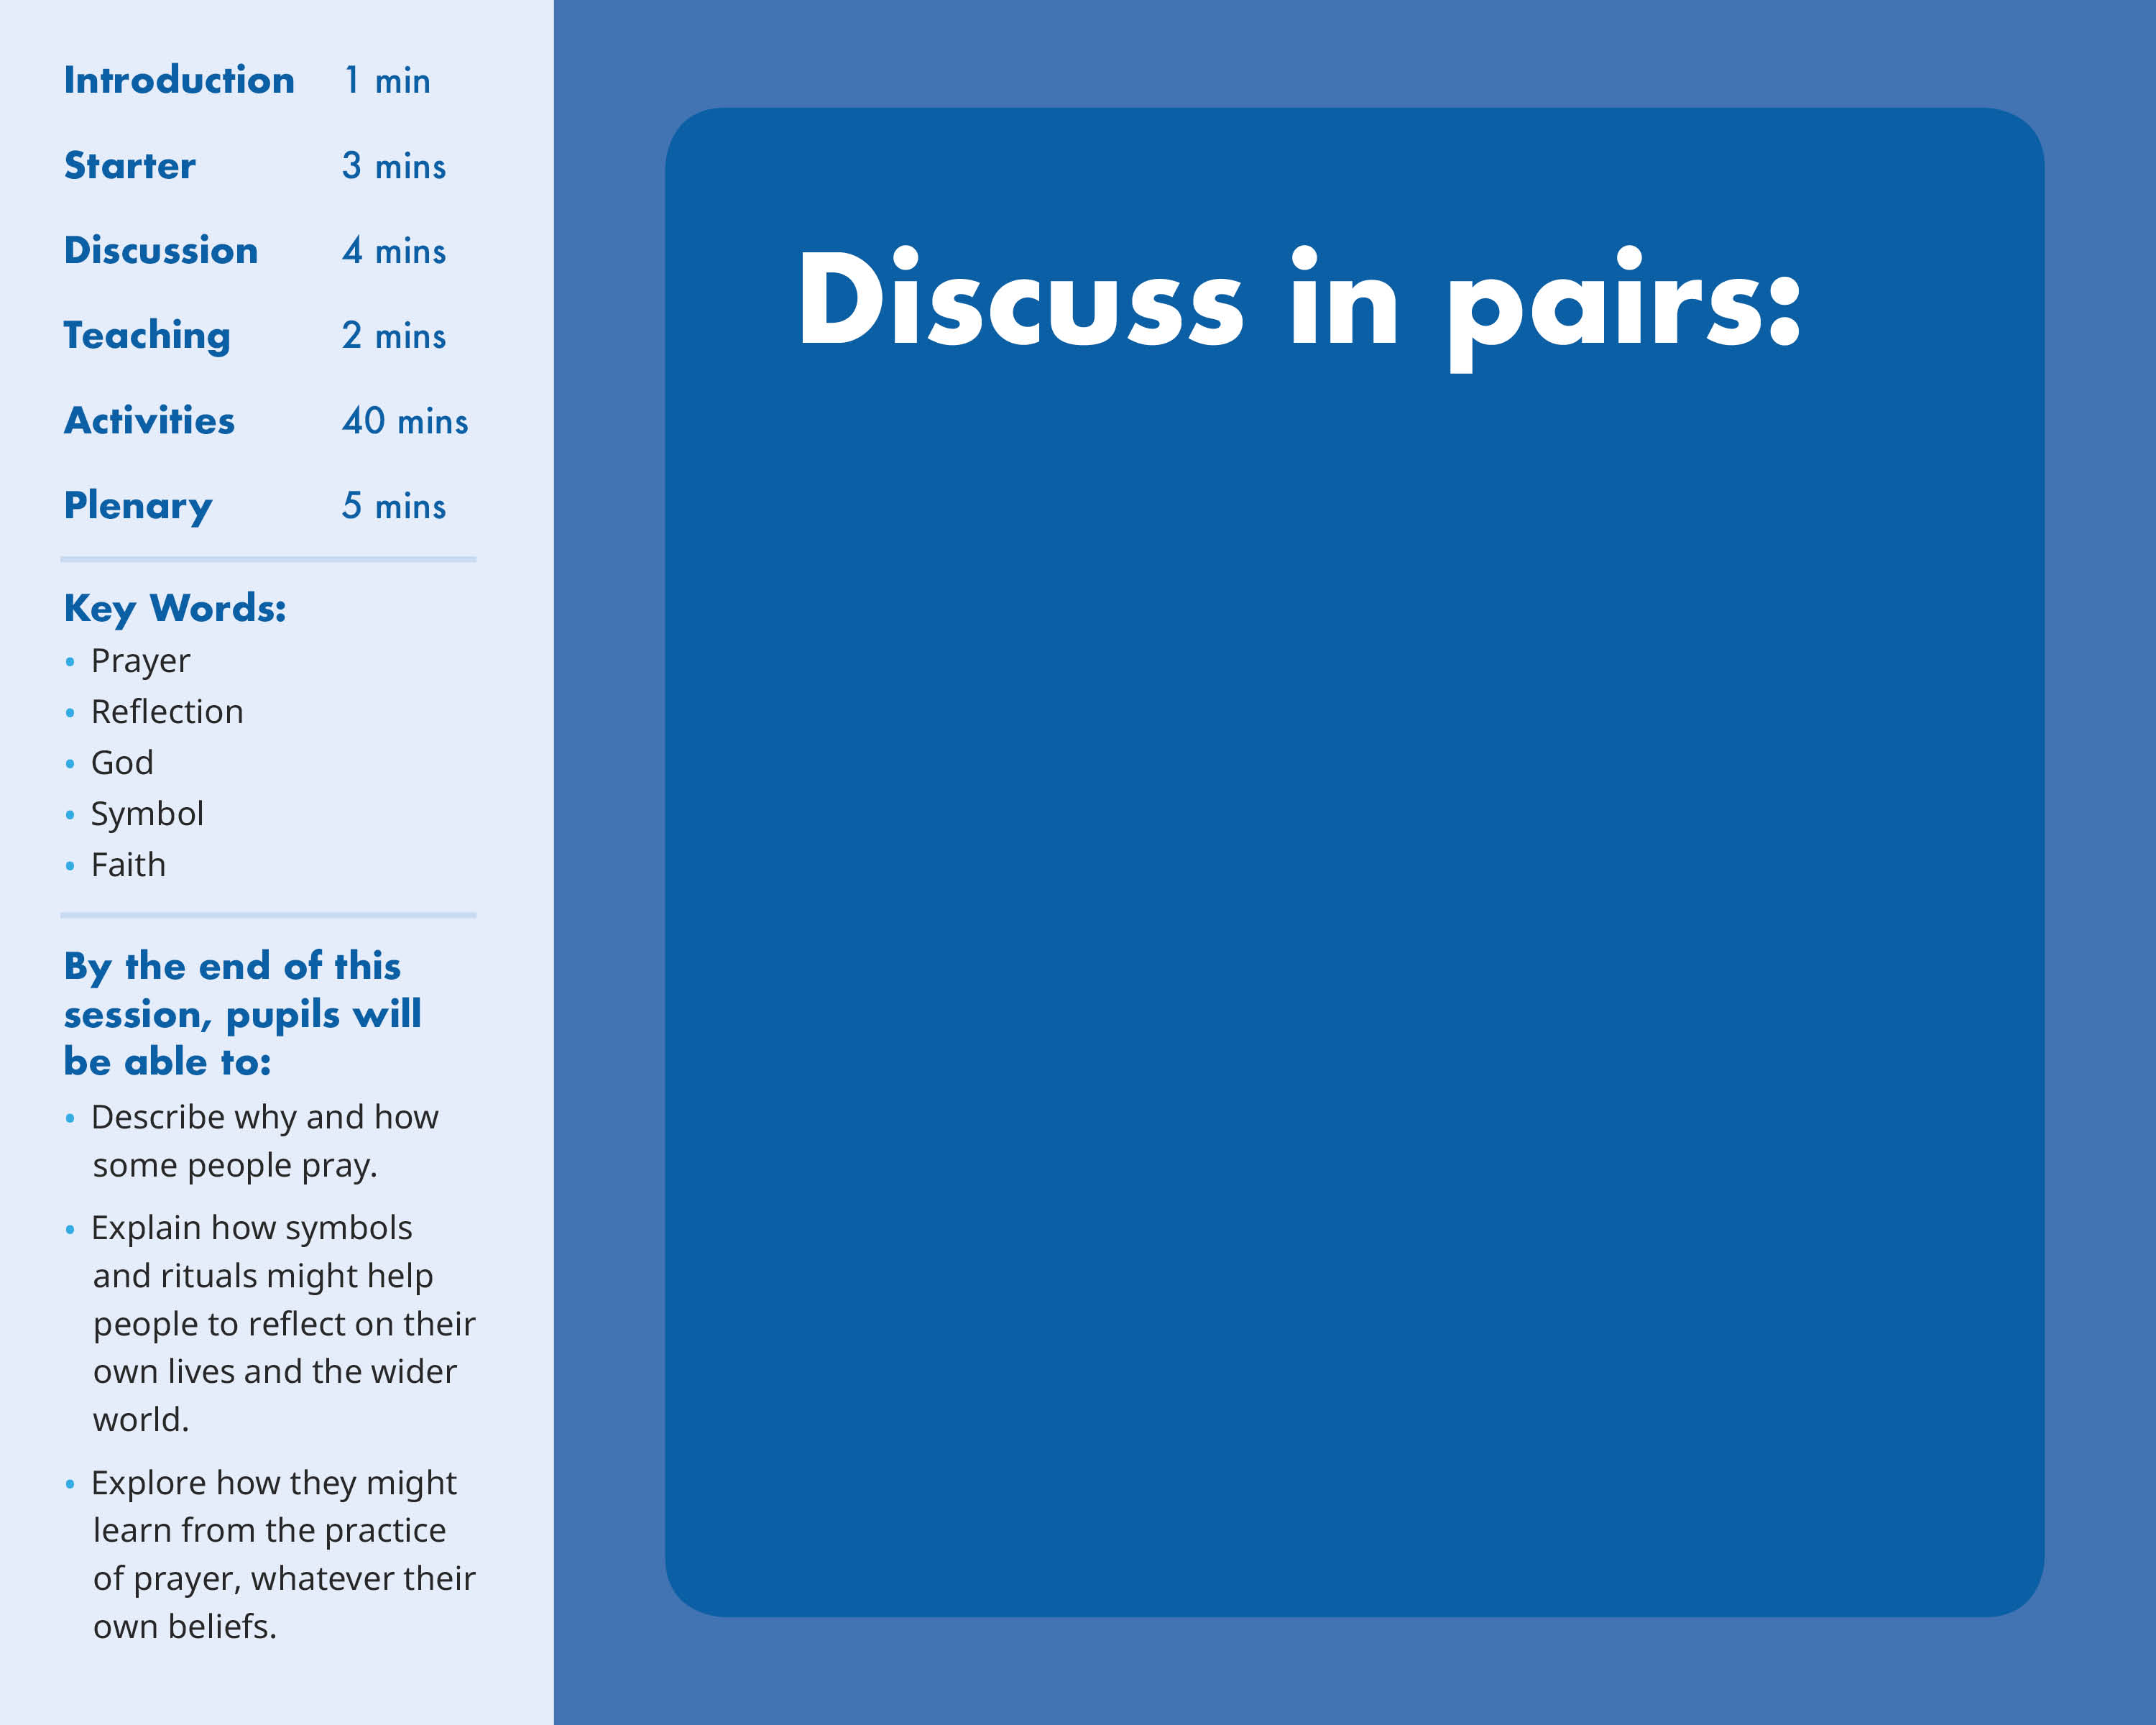

What is prayer – can you form a simple definition?
Think of 3 situations in which someone - whether religious or not - might pray
How might someone pray?
Think about location, posture, rituals, symbols…

Slide 3
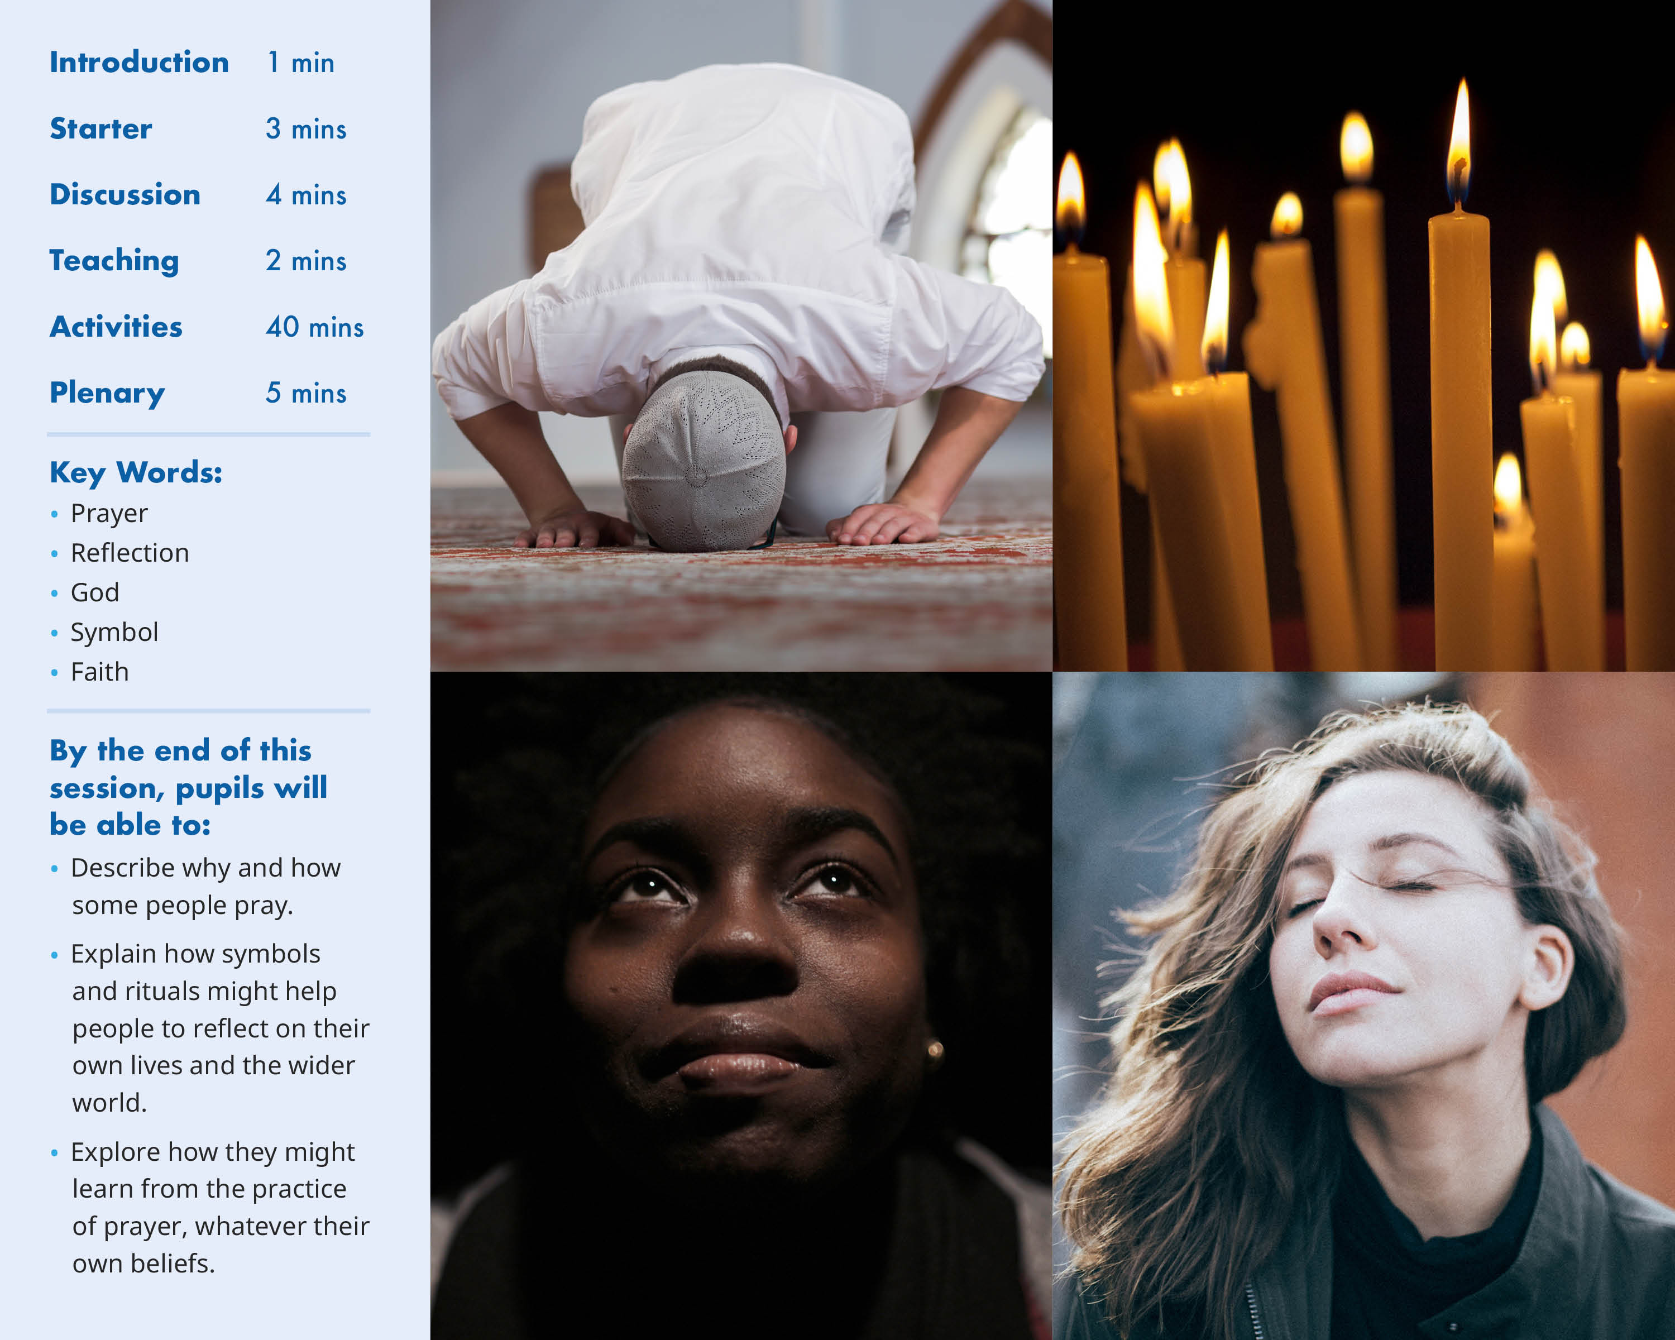

Slide 4
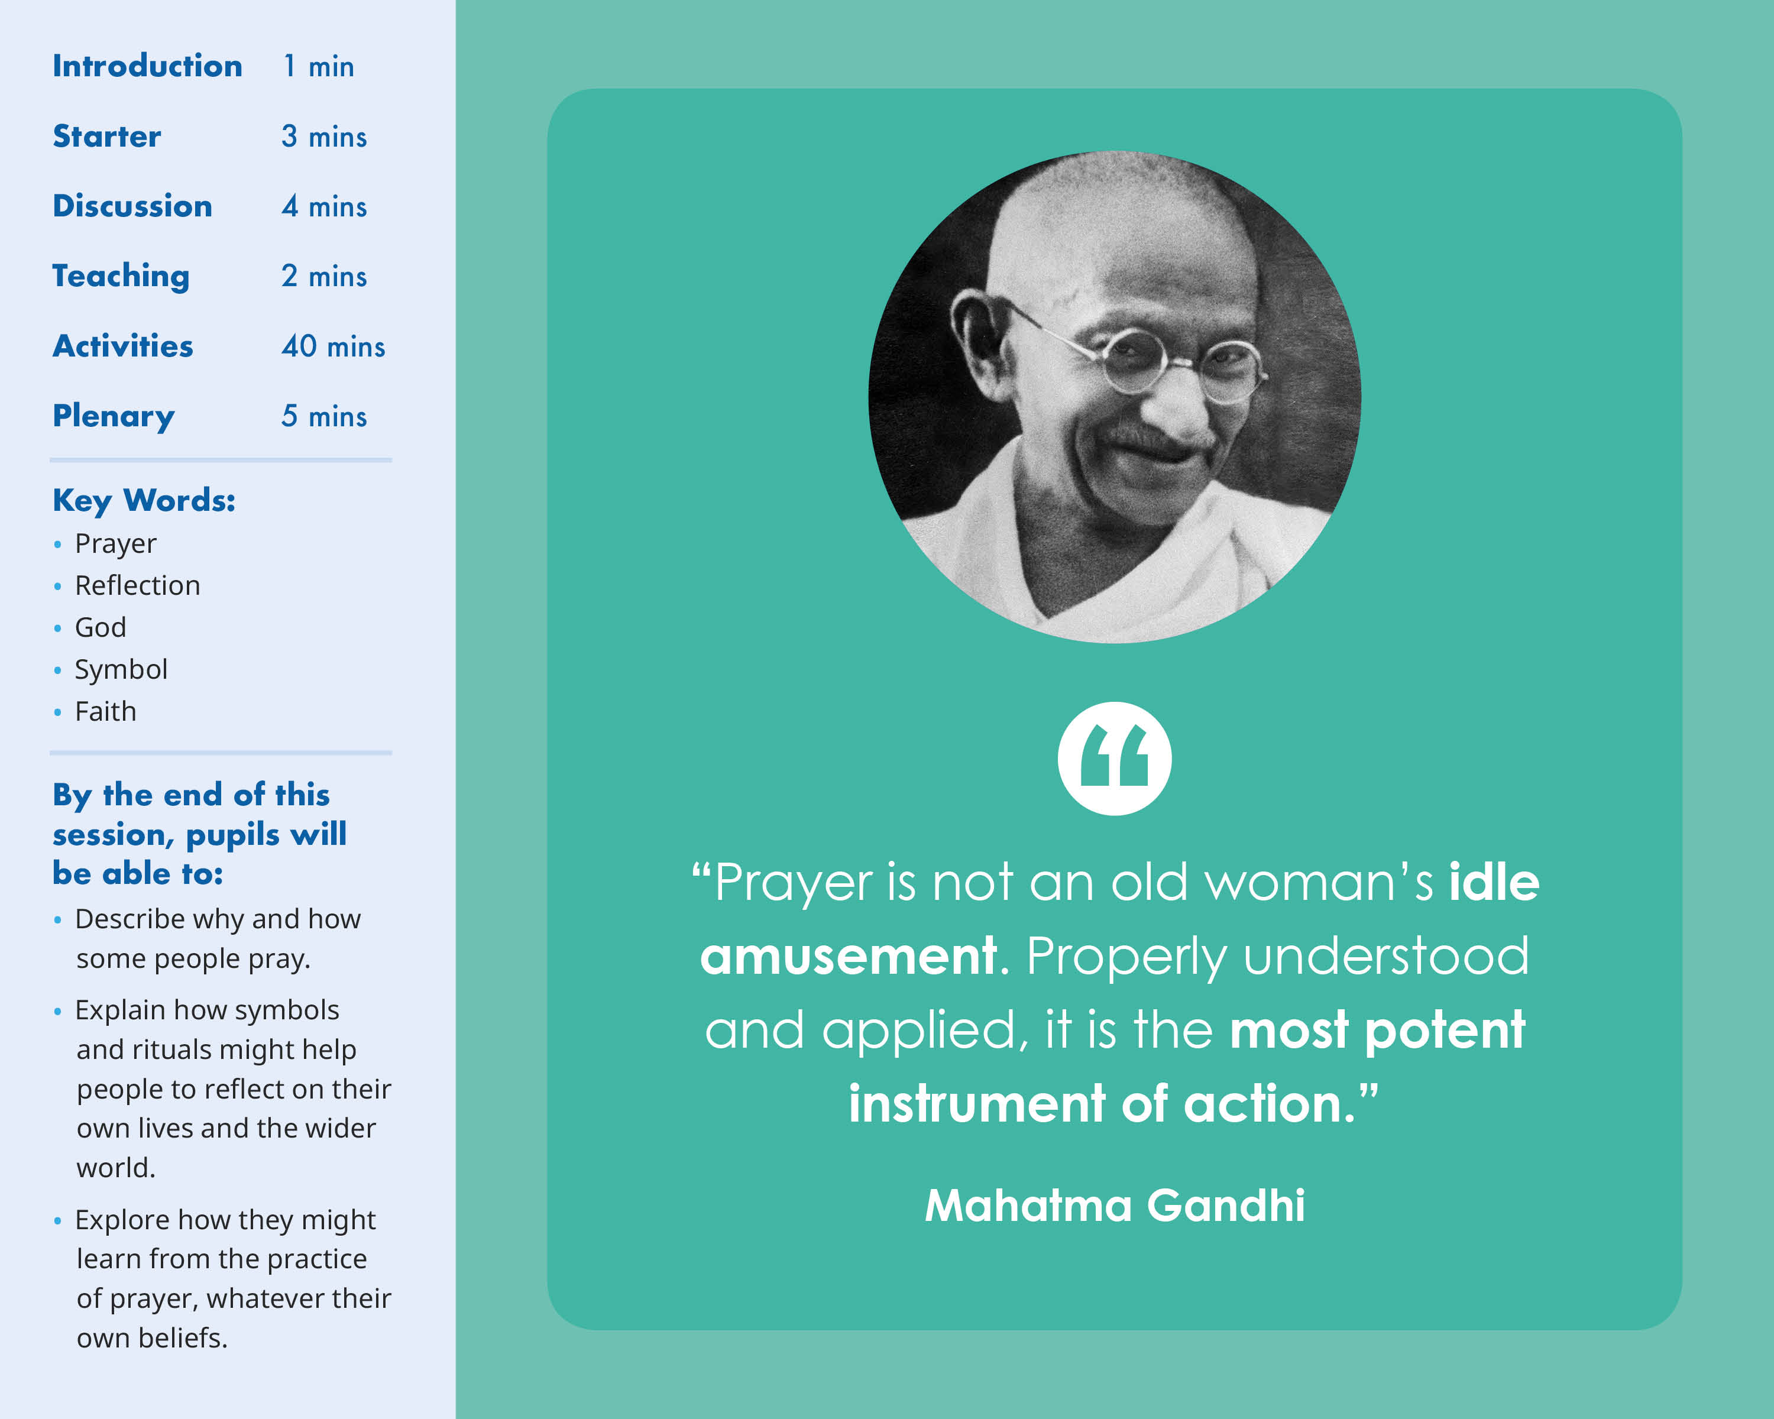

Slide 5
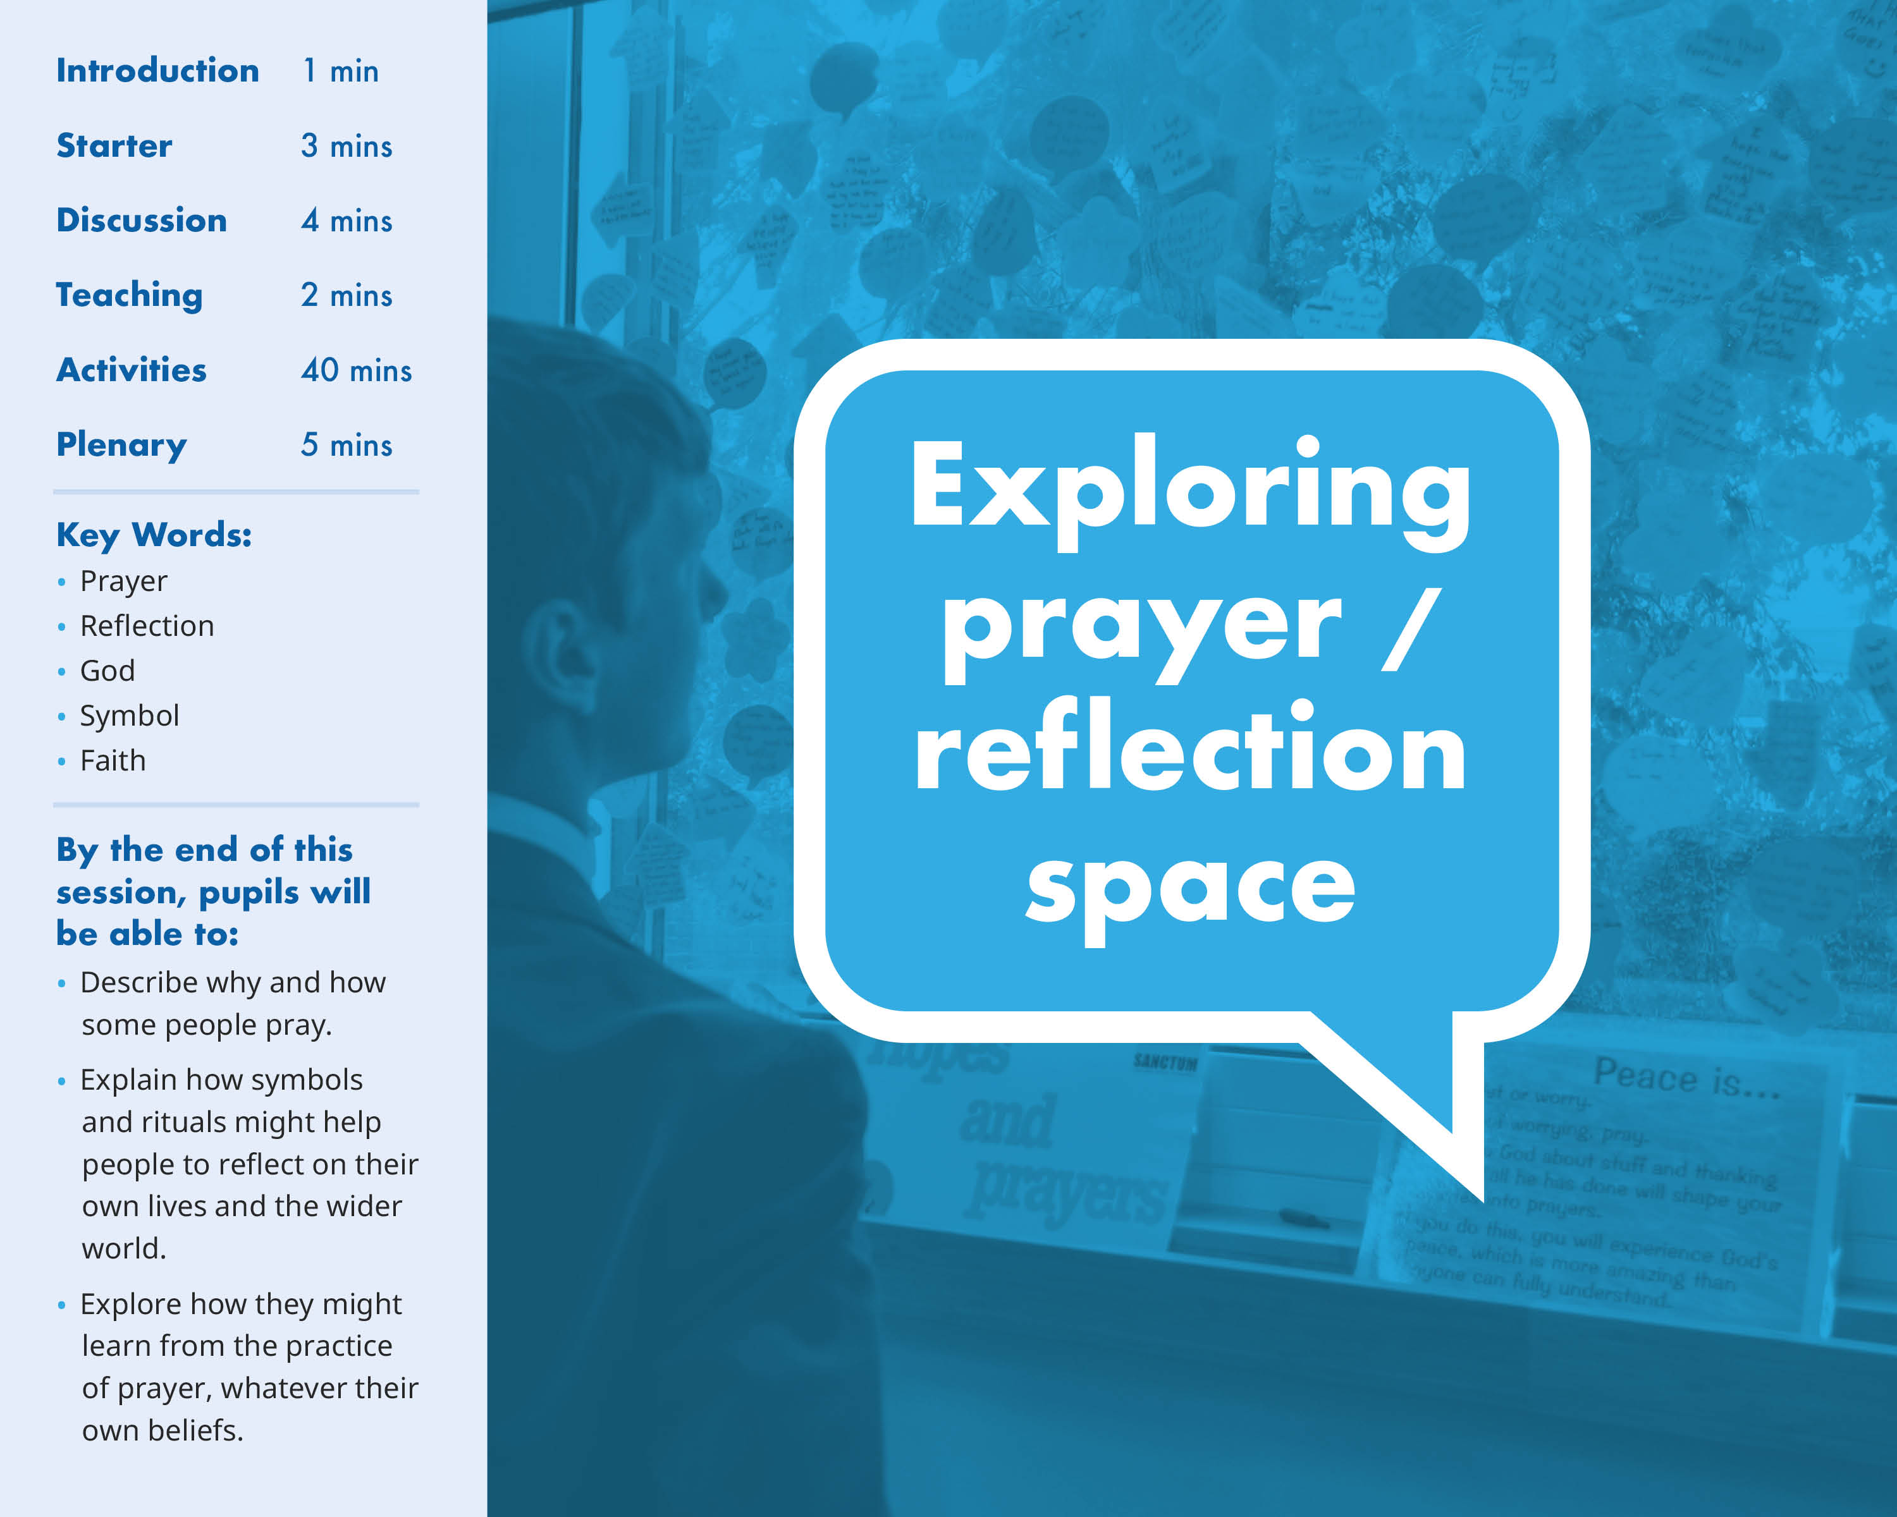

Slide 6
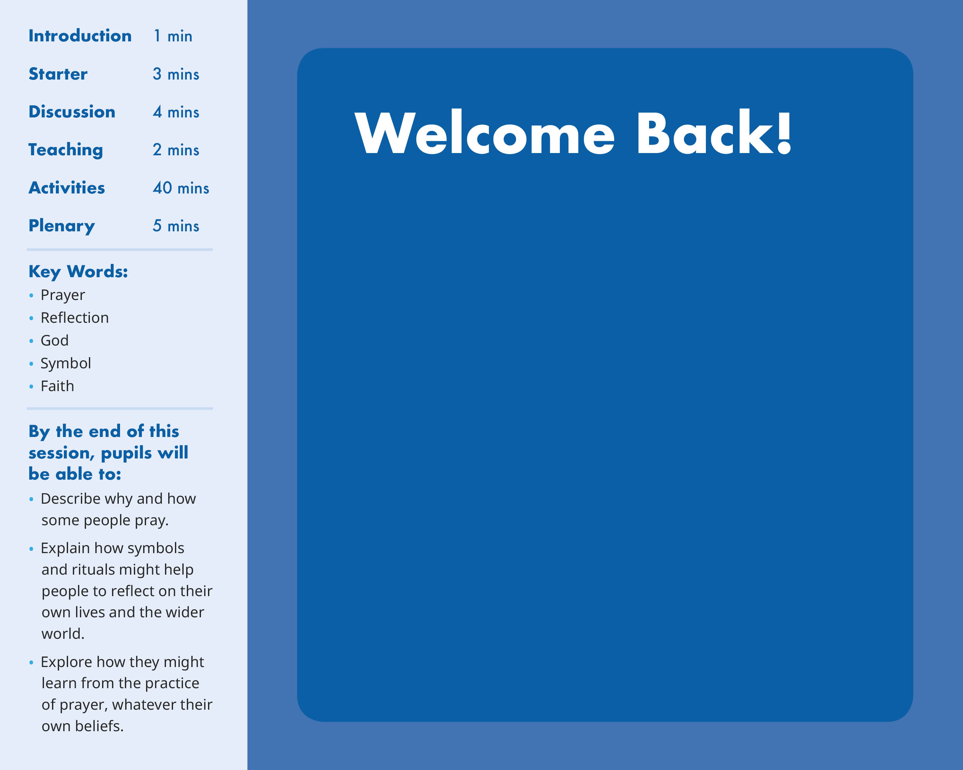
Which activity did you found most helpful and why?
Which activity did you find most challenging and why?
Would you describe prayer differently now that you have used the prayer space?
If prayer formed a regular part of a person’s life, what might be the impact on them and on their daily life?

