Slide 1
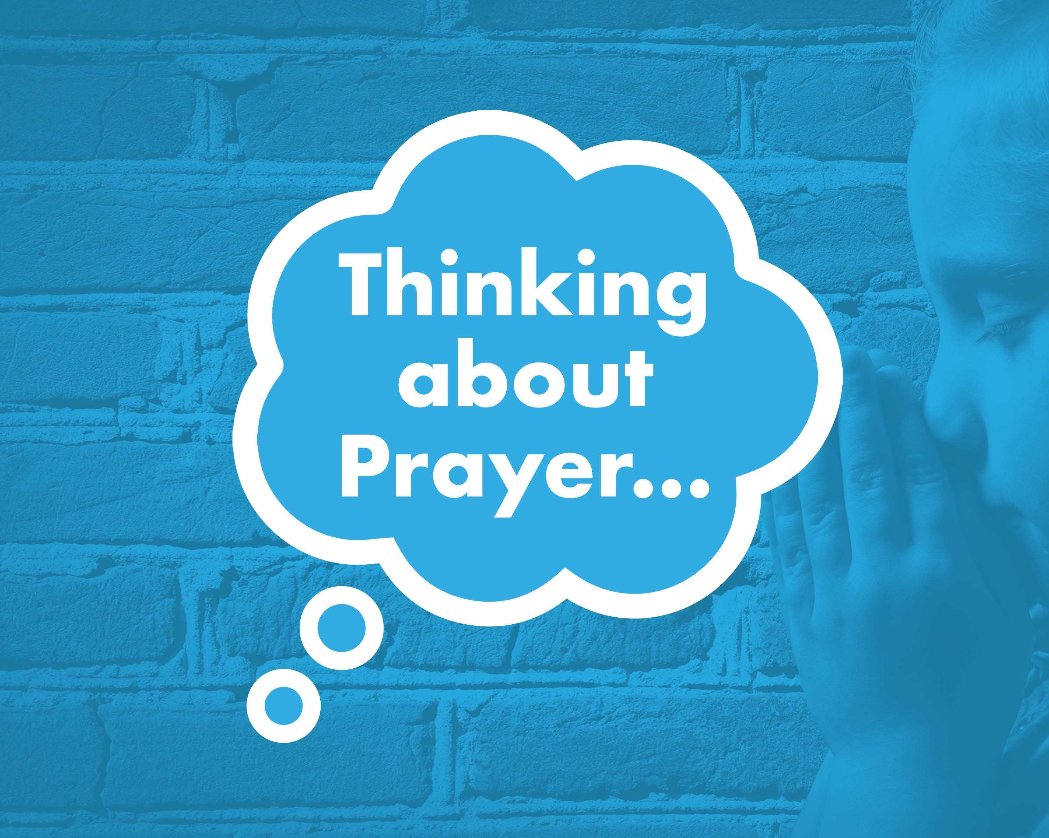

Slide 2


What is prayer?
Why might somebody pray?
Who might pray?
Where might they pray?
How might someone pray?

Slide 3
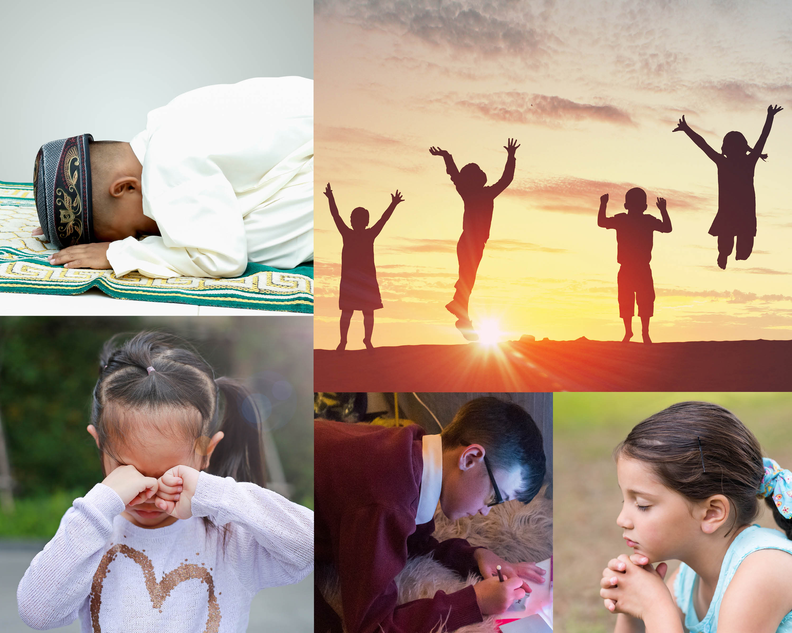

Slide 4
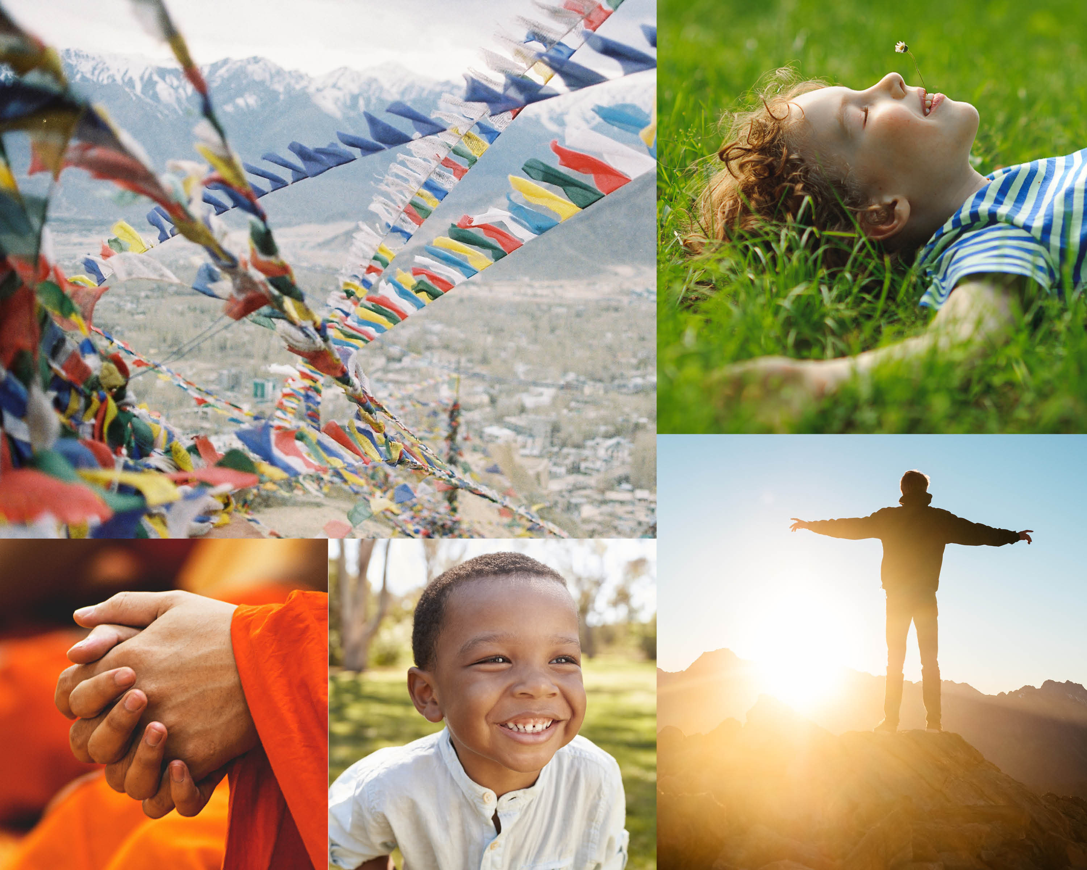

Slide 5
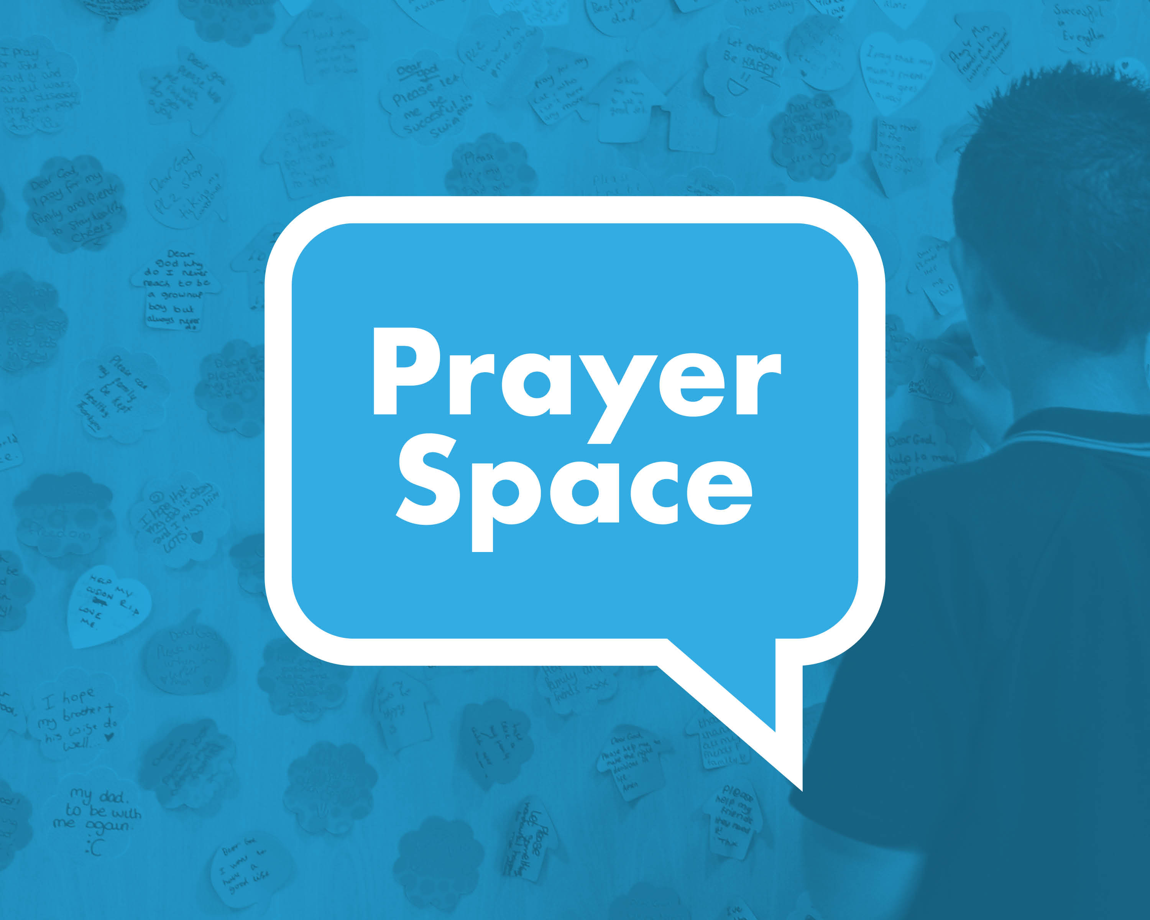

Slide 6

Which activity did you most enjoy/why?
Which did you find most challenging/why?
Which symbols (objects or actions) did you discover?
How did the prayer space make you feel?
Would you recommend stopping to pray/reflect to a friend? Why?
Which were helpful?

