Slide 1
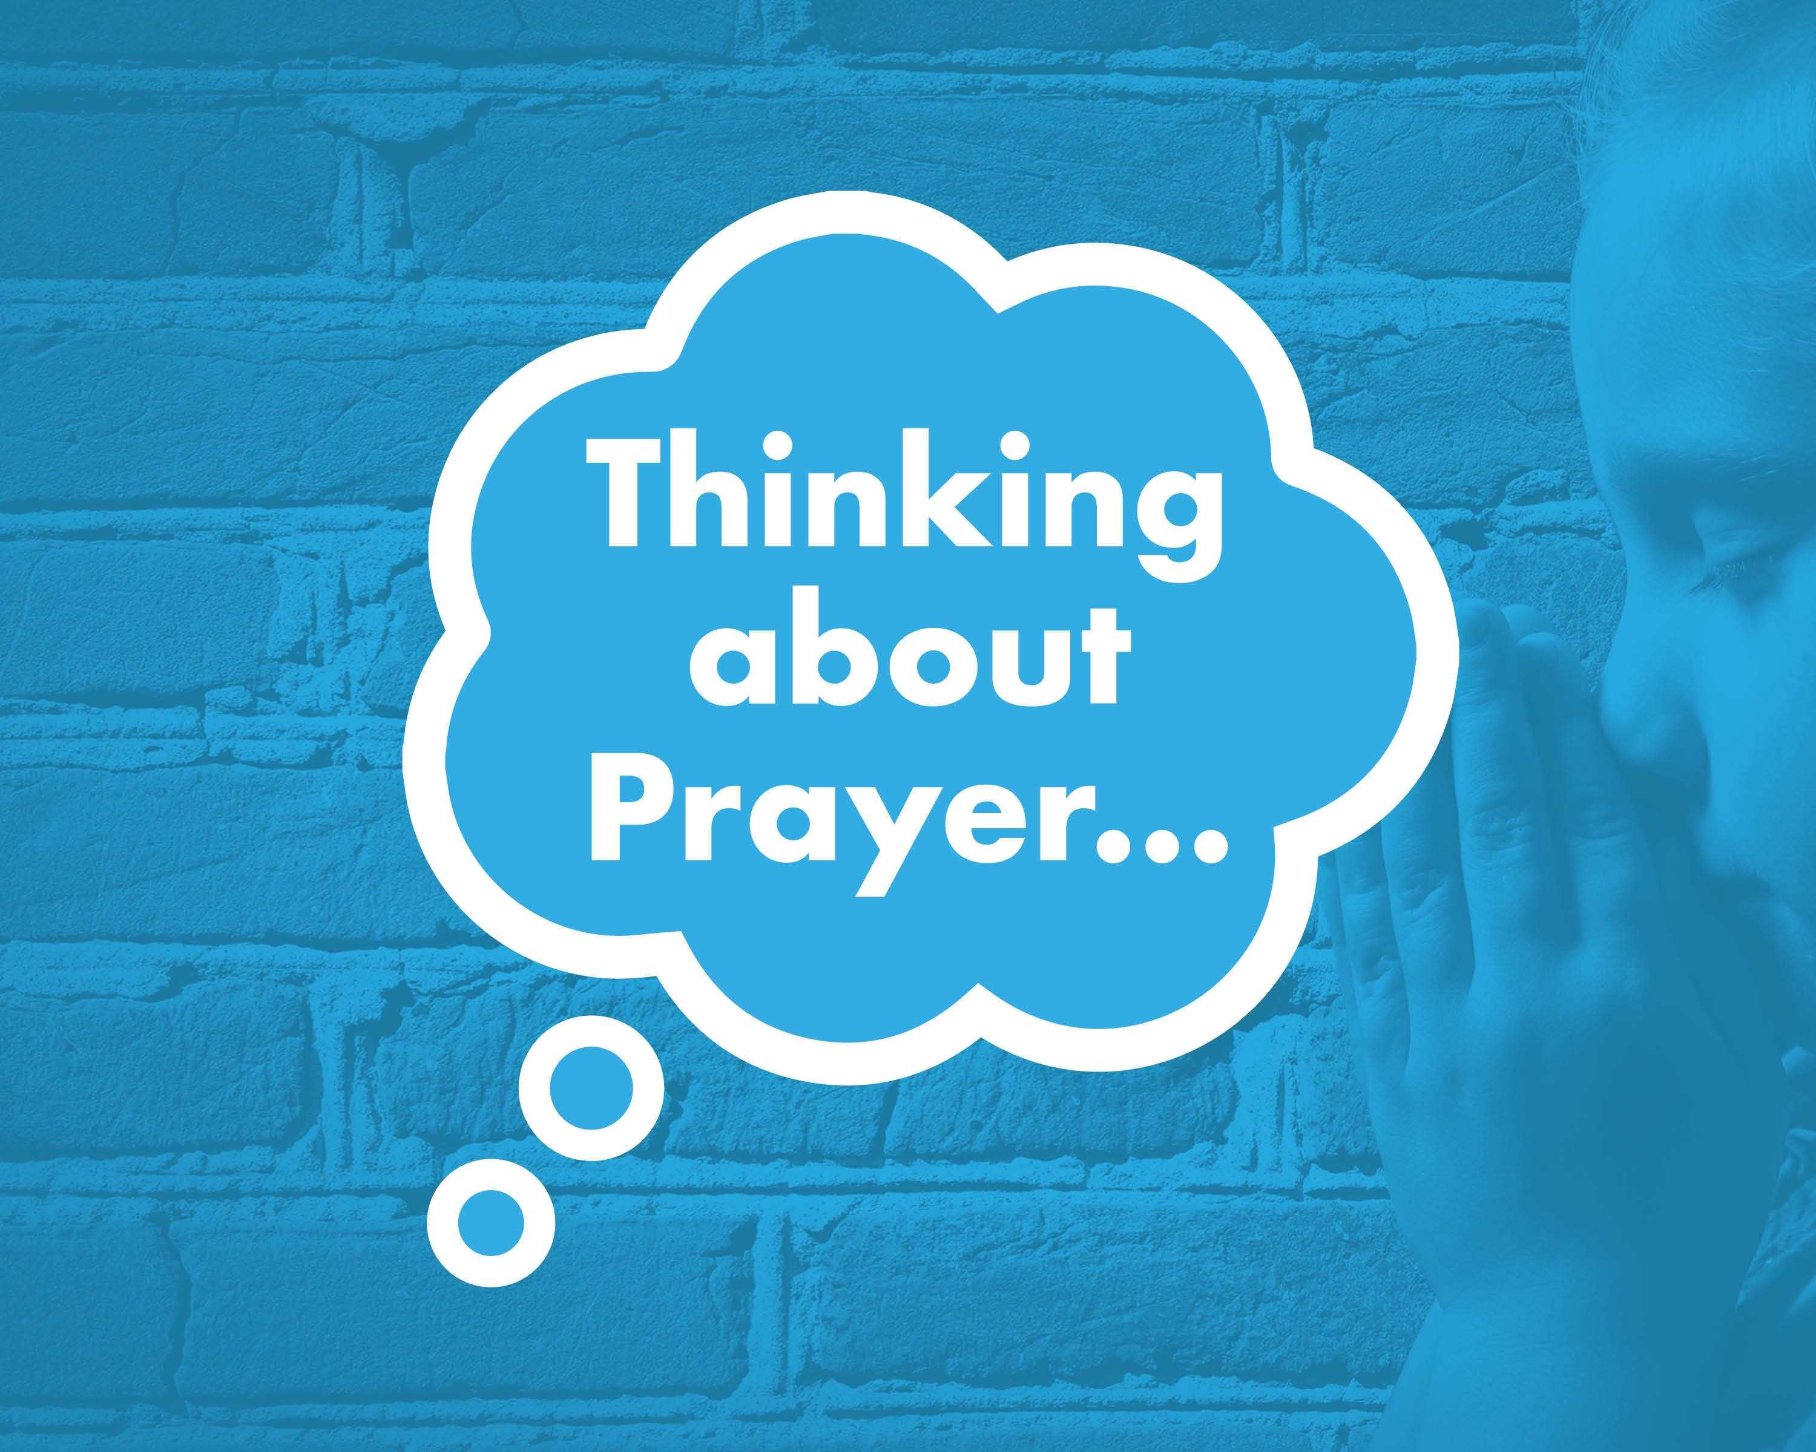

Slide 2


What is prayer?
Why might somebody pray?
Who might pray?
Where might they pray?
How might someone pray?

Slide 3
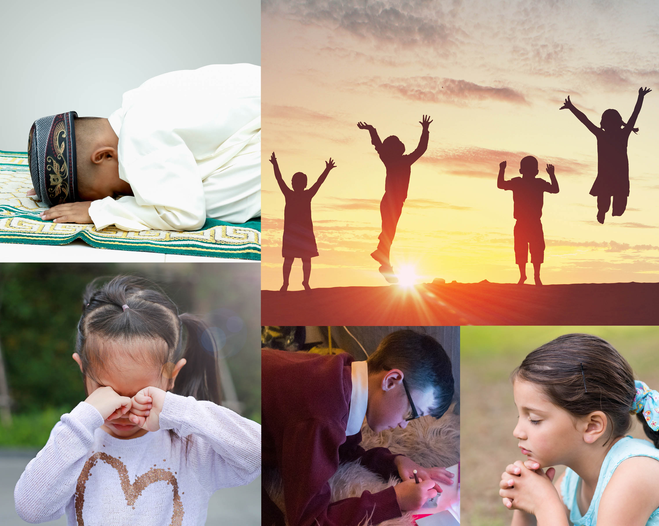

Slide 4
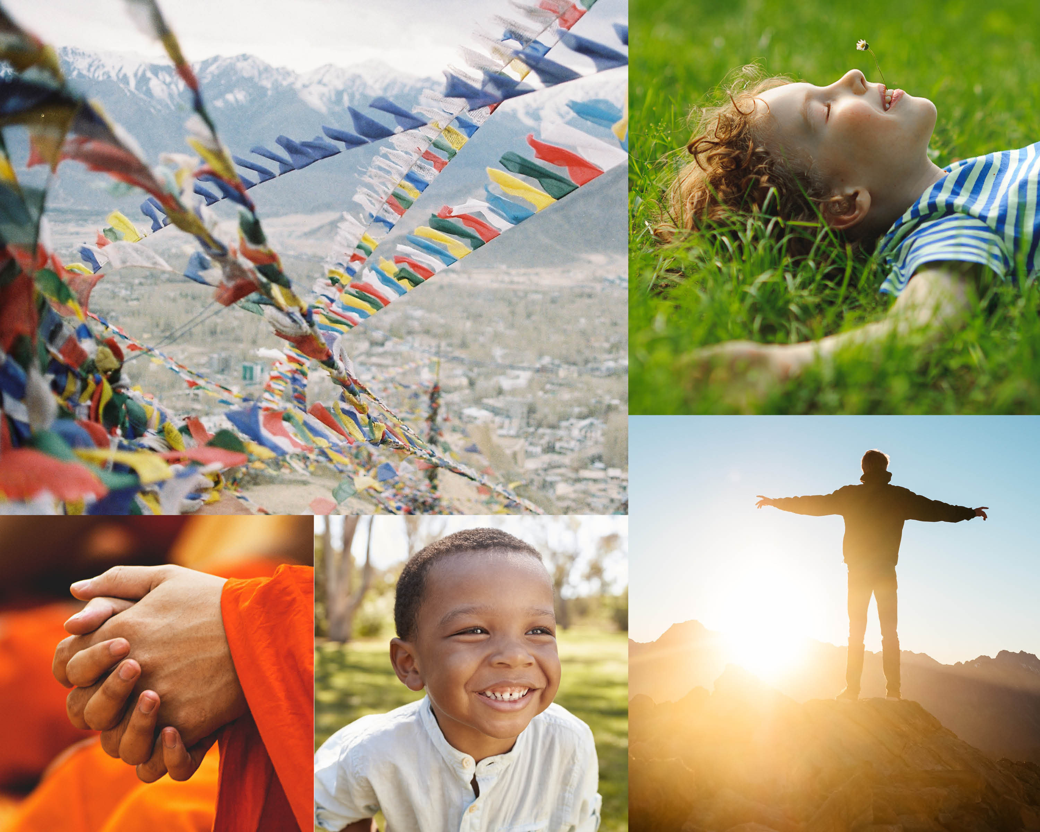

Slide 5
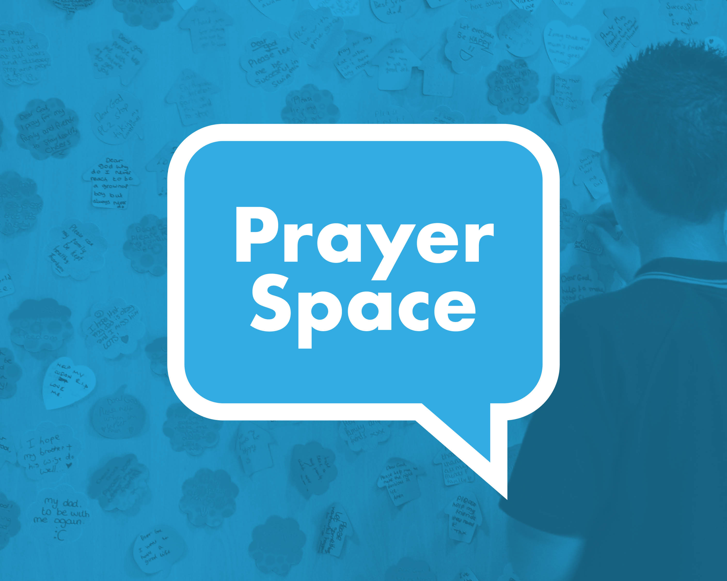

Slide 6

Which activity was the most fun/why?
What did you think about in the prayer space?
How did the prayer space make you feel?

