Slide 1
Findings from a Qualitative and Quantitative Study into the impact of prayer spaces on the spiritual development of children and young people
prayerspacesinschools.com/research2017
/prayerspacesinschools
@prayerinschools

Slide 2
Prayer spaces enable children and young people, of all faiths and none, to explore spirituality, faith and life’s big questions in a safe, creative and interactive way.

Slide 3
Prayer Spaces in Schools equips local churches to serve the ongoing spiritual life of their school communities.

Slide 4
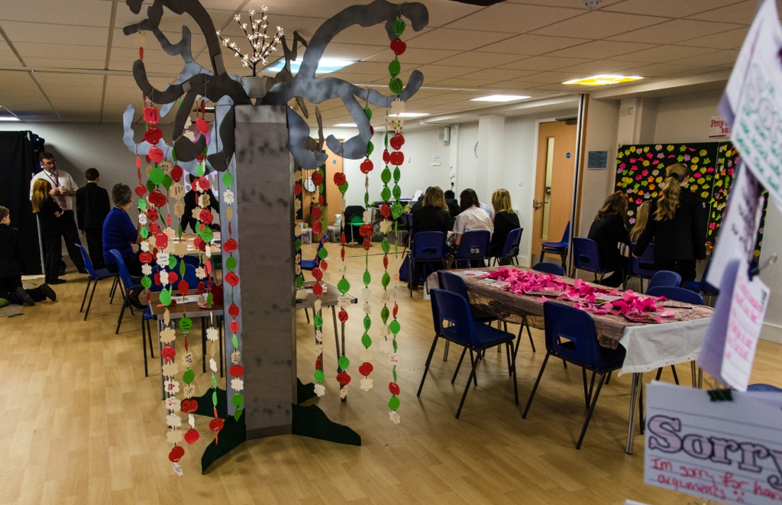
Secondary school classroom

Slide 5
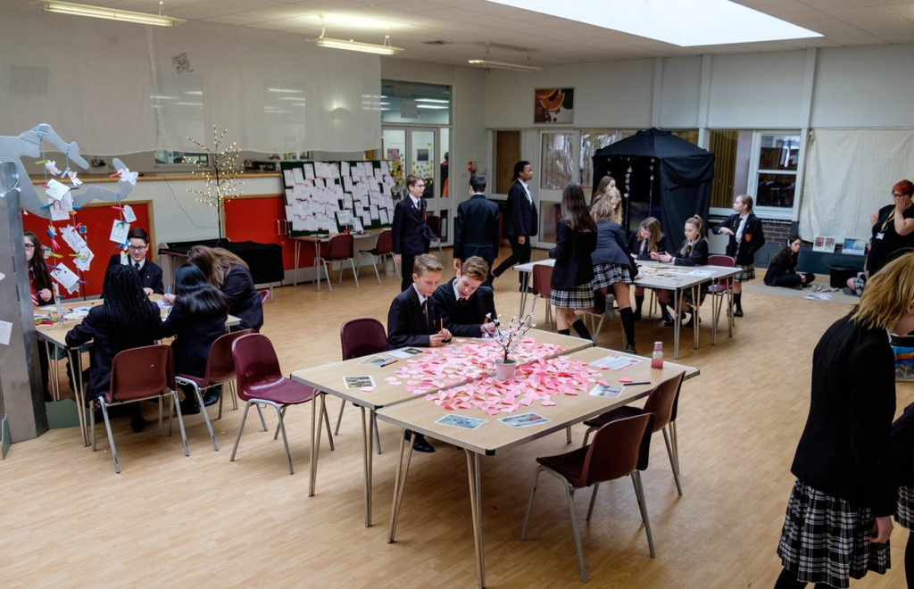
Secondary school small hall

Slide 6
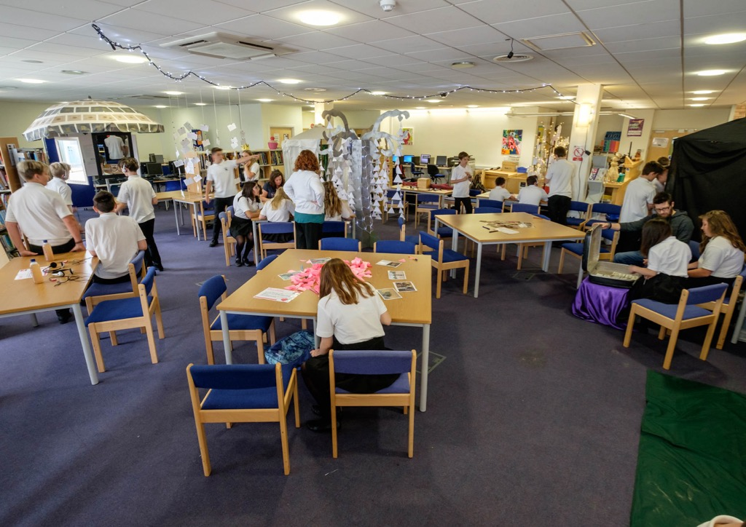
School library

Slide 7
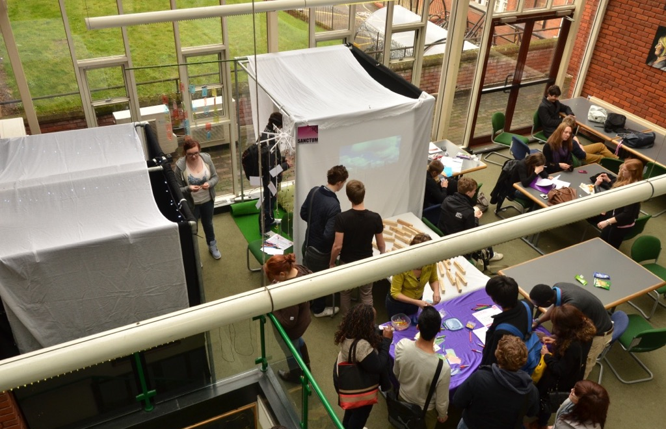
Sixth Form College concourse

Slide 8
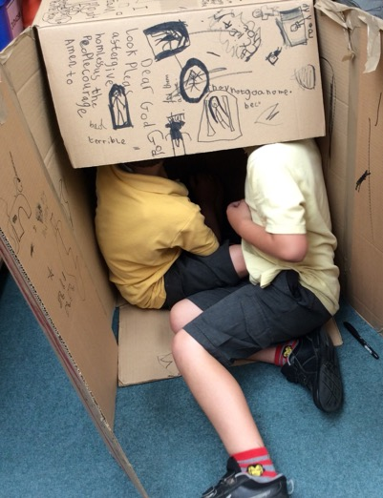
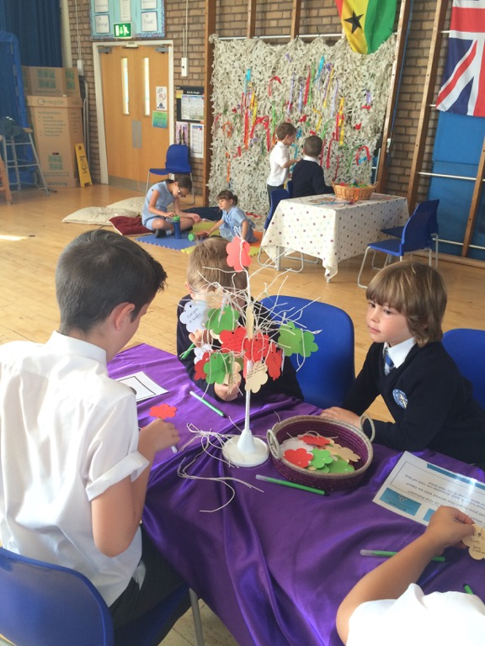
Primary school

Slide 9
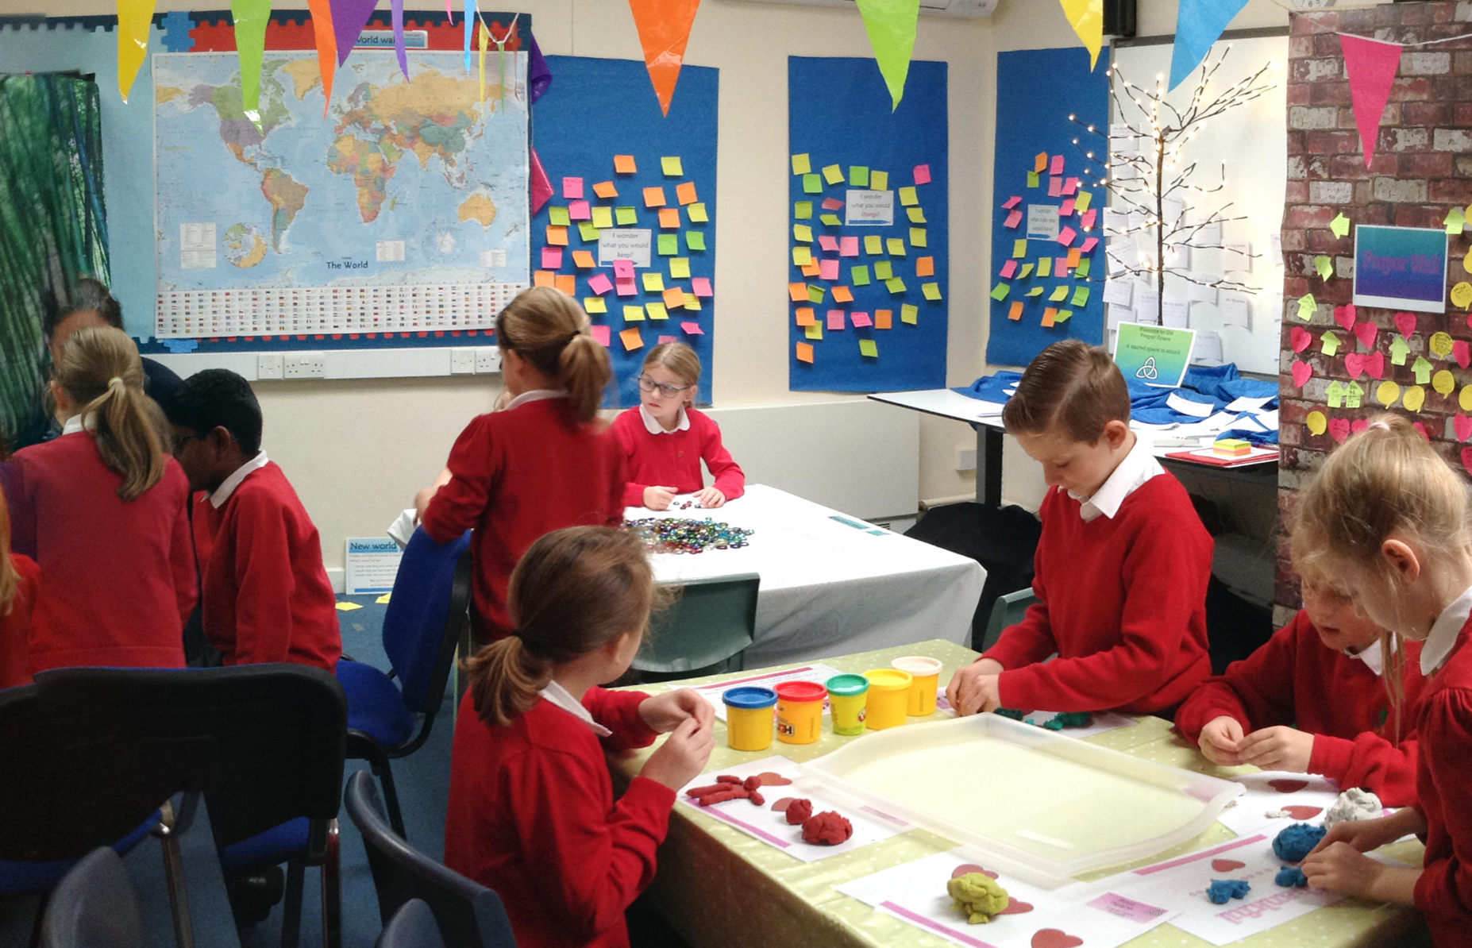
Primary school

Slide 10
Aim – to research and evaluate the contribution of prayer spaces to the spiritual development of children and young people.

Slide 11
Research tools
Questionnaires
555 pupils
aged 7–16
from 24 schools

Slide 12
Research tools
Interviews
71 pupils
15 teachers
from 7 schools

Slide 13
The schools
Primary
6 community
11 with a religious foundation
Secondary
4 community
3 with a religious foundation

Slide 14
Spirituality as relational consciousness
Relationship with:
self
others
the world
the sacred and divine

Slide 15
Relationship with the self

Slide 16
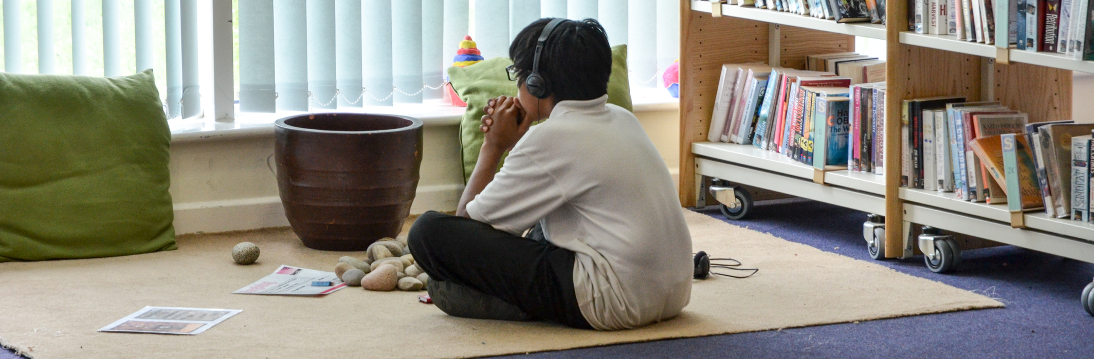
Self
The opportunity to be comfortably alone with themselves.
“I felt calm because it was silent.”
“It’s quite stressful school sometimes, so I thought that the prayer space was really relaxing and it… helped me think about things that are more important than what I have been worrying about.”

Slide 17
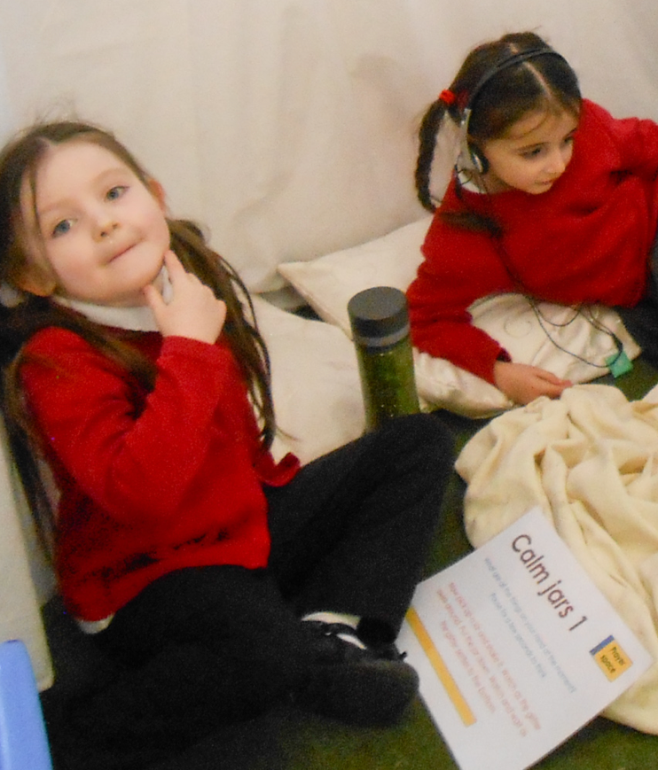
Self
The opportunity to engage in internal conversation with themselves.
“I think it’s like a conversation that you’re having with yourself because it’s sort of saying one thing in one half of your mind and you’re saying it again in your other half which I quite like.”
“I was having a conversation in my head about what peace is and what forgiving is all about.”

Slide 18
Relationship with others

Slide 19
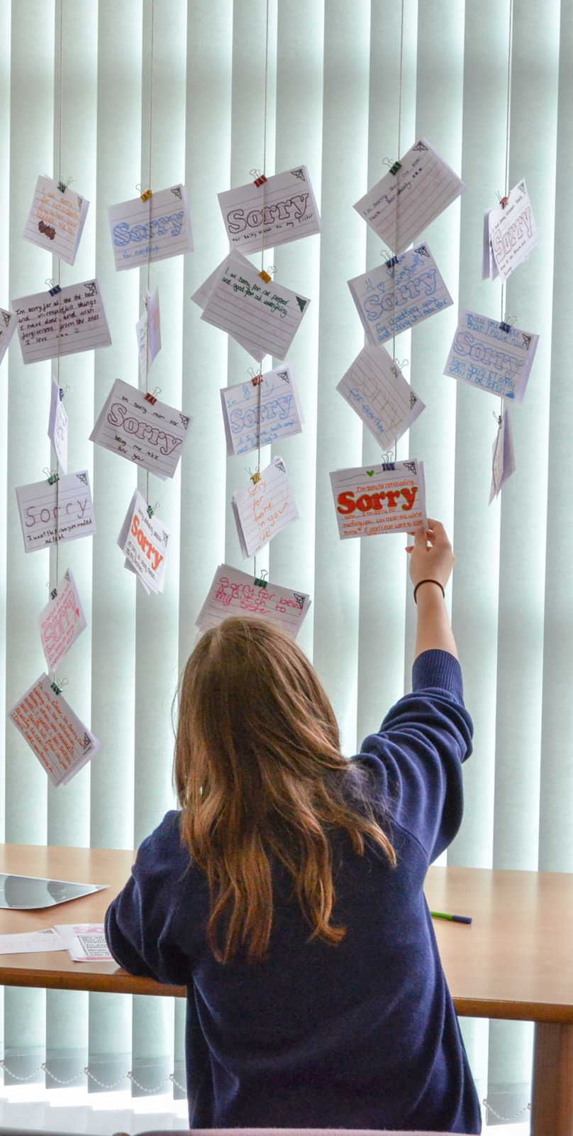
Others
Some pupils noticed how their time in the prayer space made a difference to their relationships.
“I’ve got on better with my sister, not argued so much.”
“It helps you come into reality of ‘I’ve done something wrong: I need to apologise’, and it just helps you go home and face what you have done.”

Slide 20
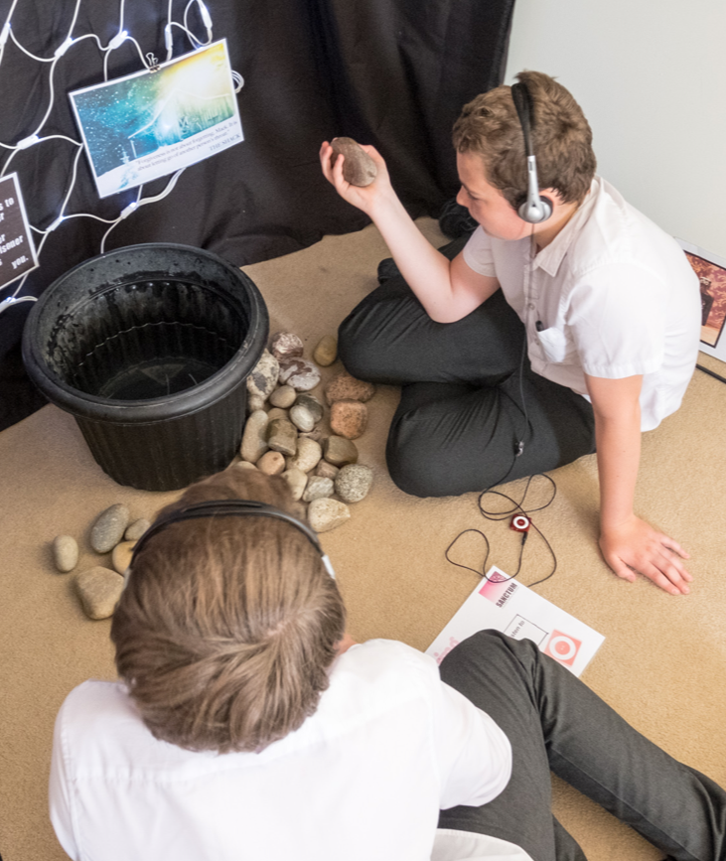
Others
Forgiving was a strong theme.
“Forgiving someone who badly bullied me … I was thinking about all the times I forgave my best friend when we got into arguments.”

Slide 21
Relationship with the world

Slide 22
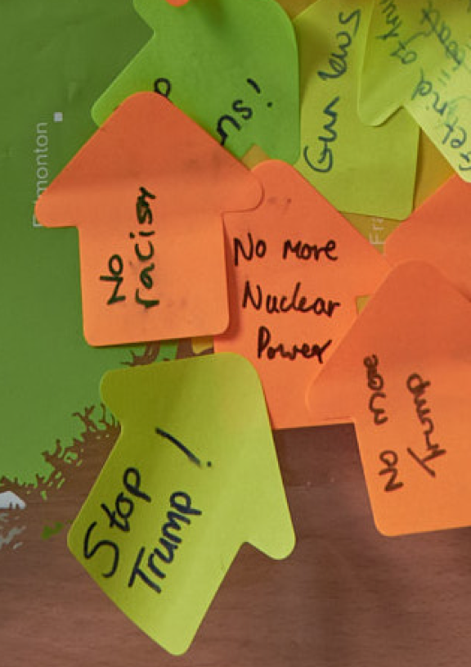
The world
Every prayer space has some activity that helps pupils focus on the wider world and on issues of injustice in our world.
“Some people worried about what Donald Trump is going to do and about the terrorist attacks in England”
“I thought about those in other parts of the world that either do not have anything to eat or house to live in... It makes you feel quite grateful for what you have.”

Slide 23
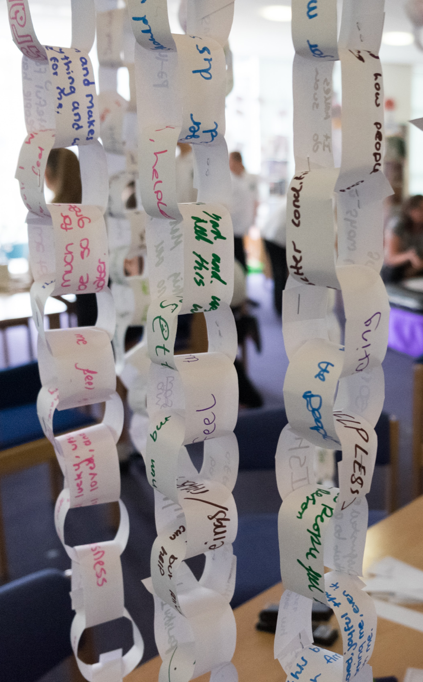
The world
“I was thinking about how I can help the whole of our community.”

Slide 24
Relationship with the sacred or divine

Slide 25
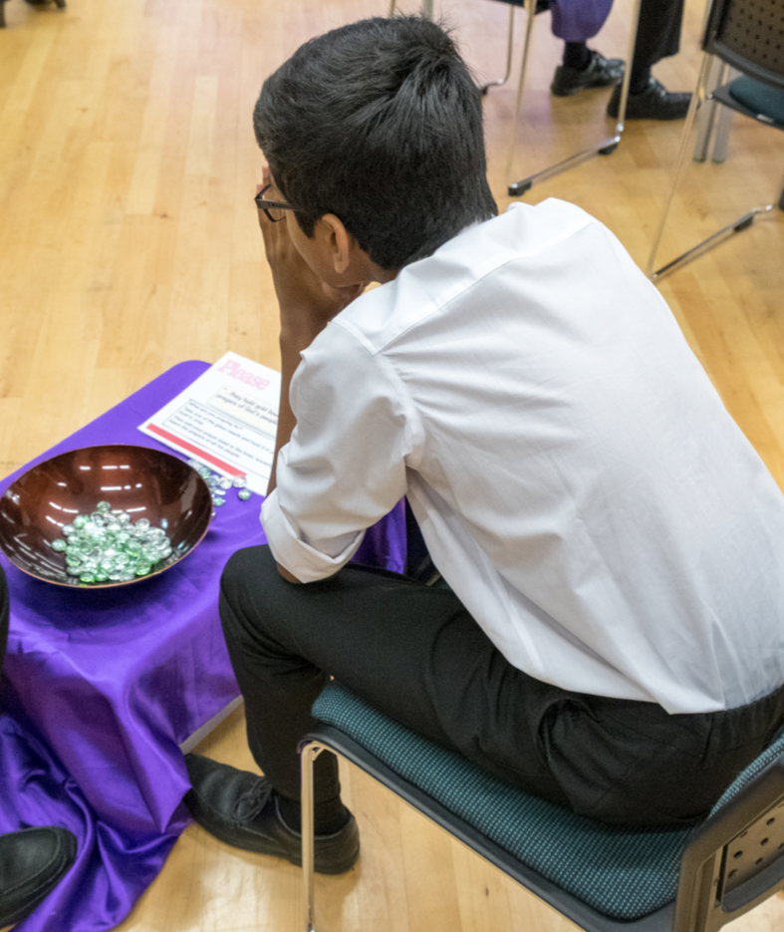
The sacred
and divine
For some pupils this connected with their everyday understanding of God.
“It’s just like you and God...can relax and you can then just go out feeling more relaxed about things.”
“It calmed me down and made me think about myself and thank God for making me.”

Slide 26
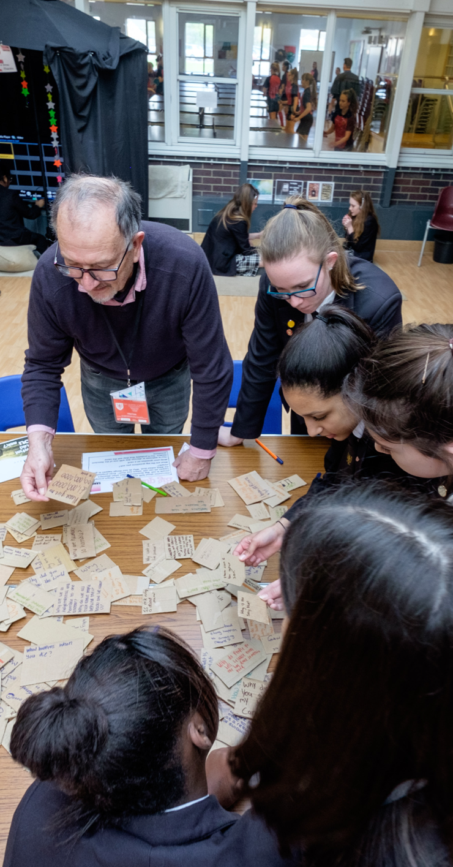
The sacred
and divine
Others affirmed the inclusivity of the spaces:
“I think it was just to help you think about your beliefs whether you believe in the religion or whether you believe in anything really. I don’t think it was trying to change you.”
“In various ways, prayer spaces were valued for being inclusive, notably for recognising and being sensitive to the various religious and non-religious positions of pupils.” Report Authors

Slide 27
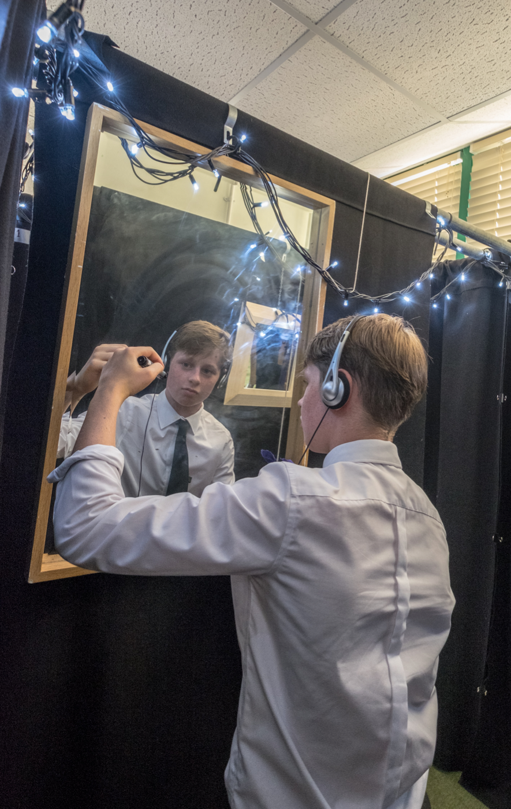
Other findings
Agency
The importance and value of creating spaces where people can engage in their own way.

Slide 28
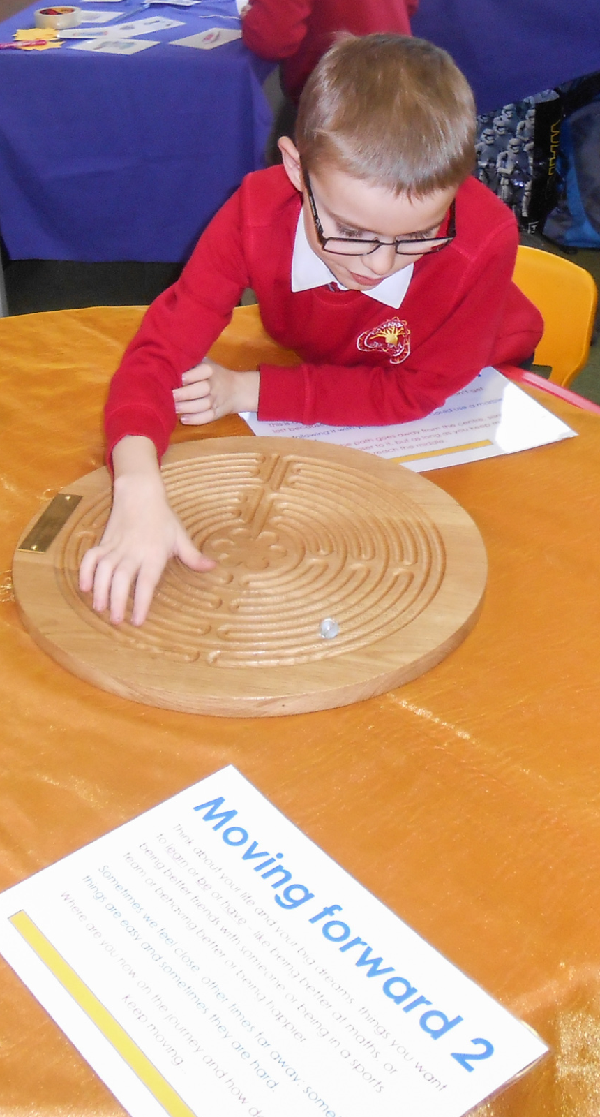
Other findings
Physicality
Interacting with physical objects and activities create a powerful learning environment and this is one of the things that pupils comment on and appreciate.

Slide 29
Other findings
Neutrality
“One of the most valuable things that works really well is having that support from outside. It’s really important. We normally have a member of staff in the space, but we try and take a back seat. The kids feel that they can access the space without being judged, or without feeling like ‘that teacher thinks I’m that’, or ‘I don’t like that teacher’. So it’s neutral when they come into the spaces, it’s a safe space and it’s a neutral space.” Teacher

Slide 30
“We can report that the evidence suggests that prayer space activities do indeed contribute to the spiritual development of children and young people.”
prayerspacesinschools.com/research2017
/prayerspacesinschools
@prayerinschools

